Slide 1
Motion Sickness Reduction for 6-DoF-Navigation in a Virtual Solar System

Slide 2
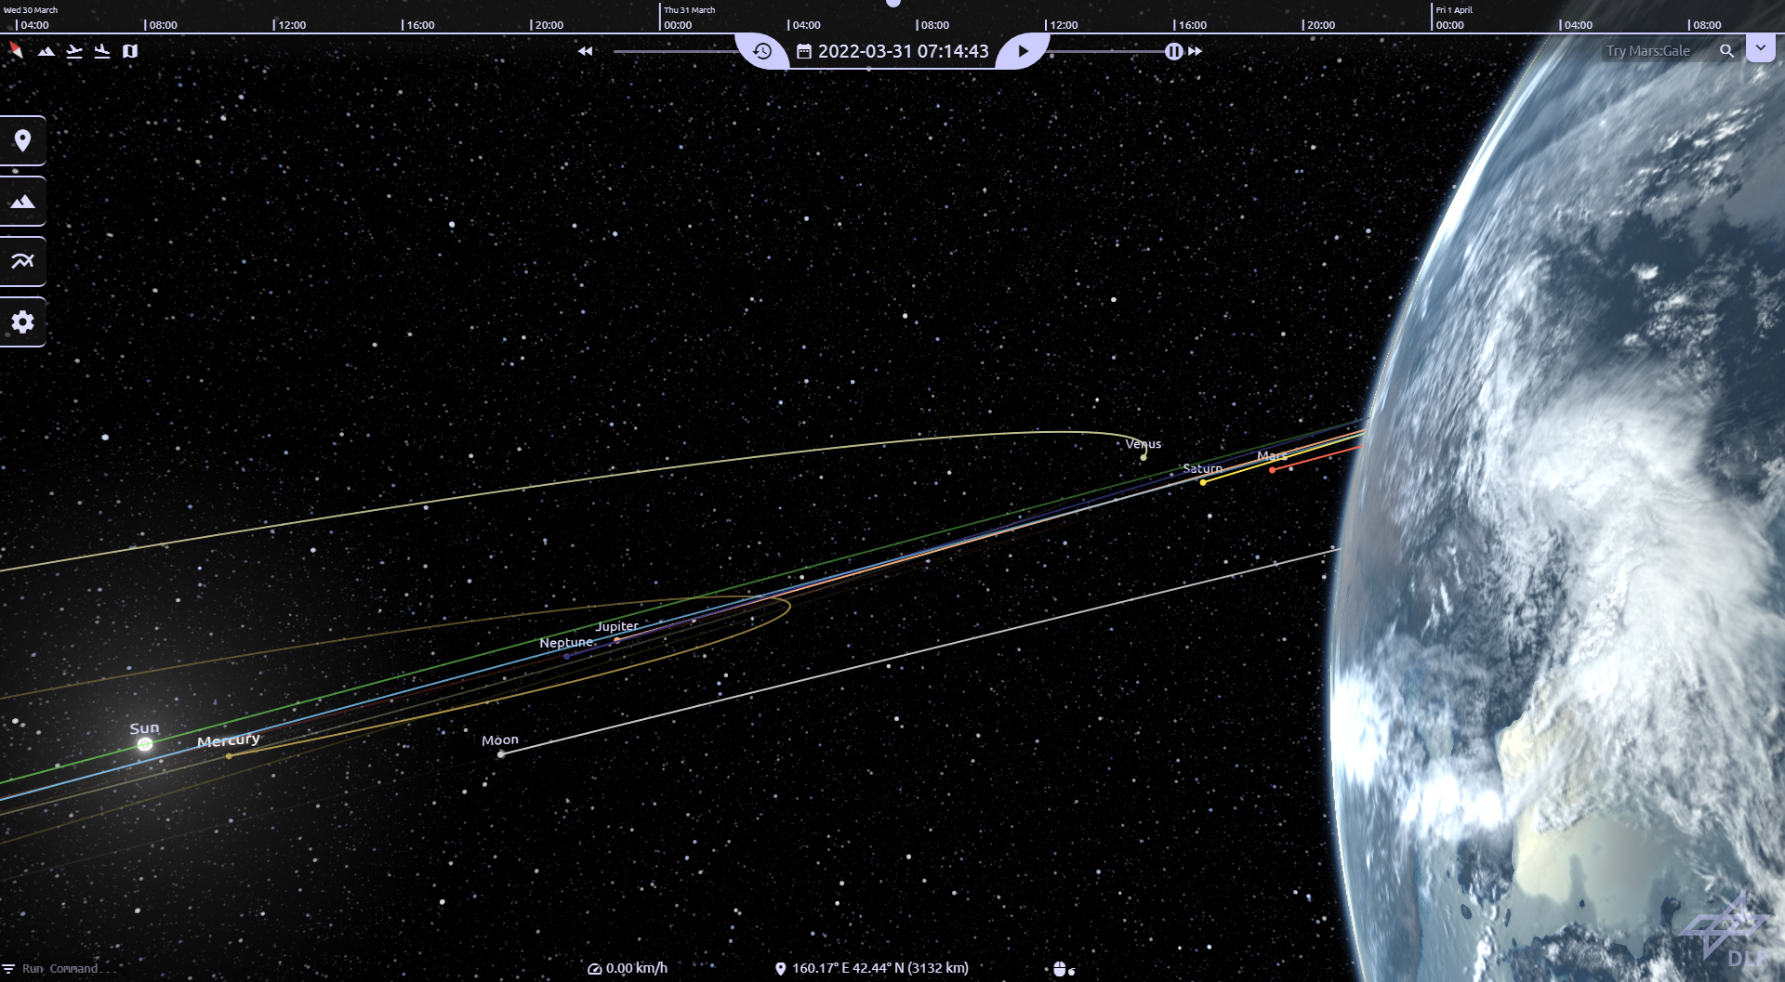
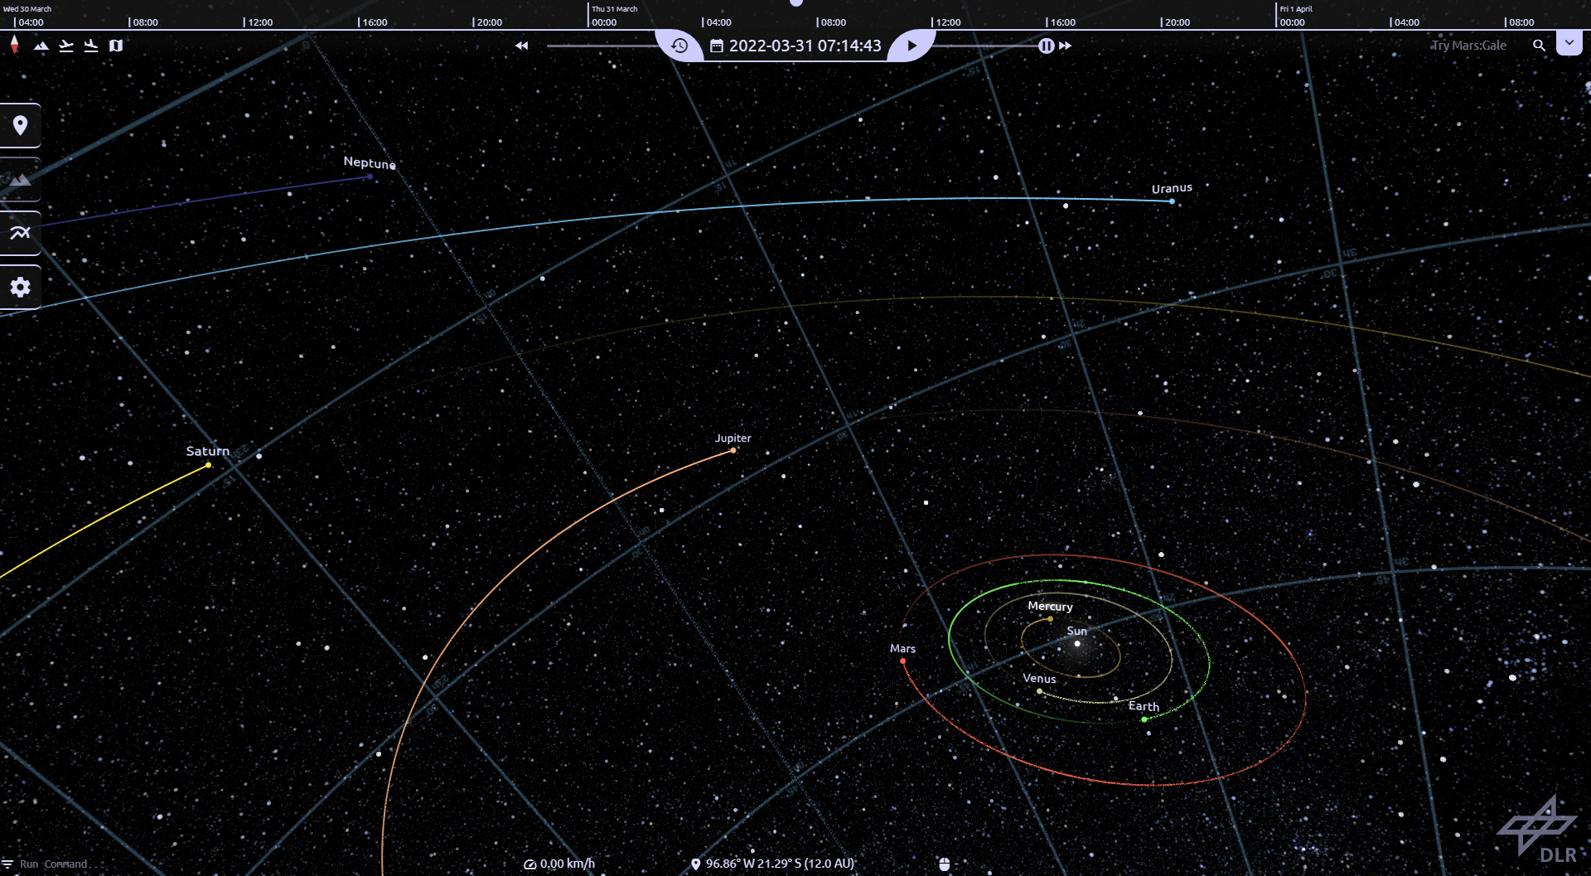
What is CosmoScout VR?
Virtual Reality Simulation of our solar system
High resolution elevation models and satellite imagery
Real-time exploration of entire planets and space missions
Scientific Visualisation of Data in VR
Notes:
- Simulation of space *and* time

Slide 3
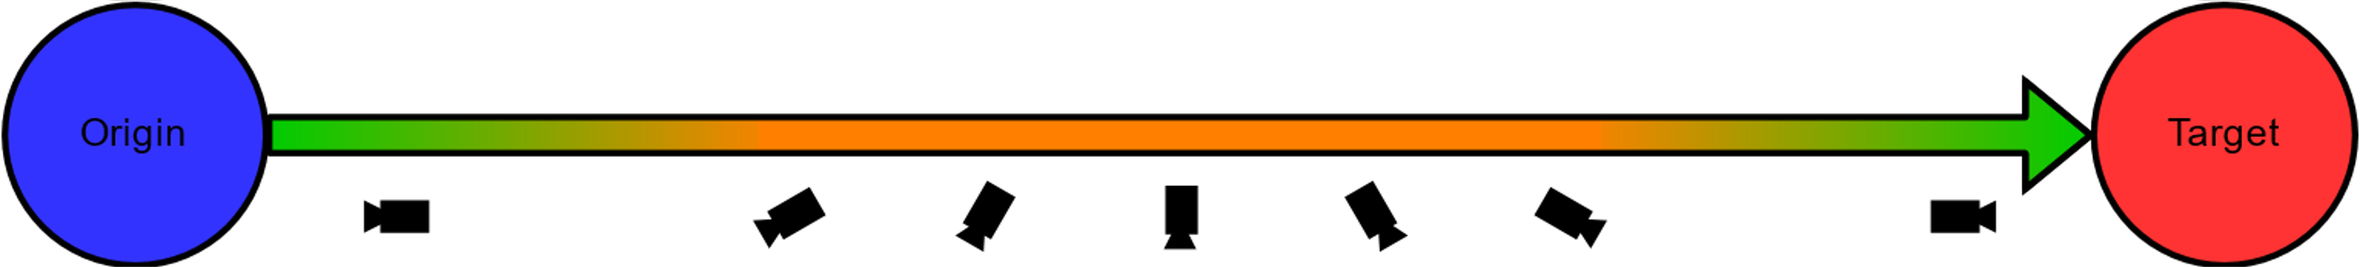
What Problems Do I Want To Fix?
6 DoF Navigation Controls with remote lead to complex rotations in free movement
Disorientation increases likelihood of motion sickness
Automatic Navigation uses simultaneous translation and rotation during travel path
Quick rotation at peak speed may induce sickness symptoms
Notes:
- Romote Controler does not allow strict separation between movements/rotations around DoF
- complex rotation can disorient the user and increase likelihood of motion sickness symptoms

Slide 4
What Causes Motion Sickness?
Sensory Conflict Theory
Information from user's senses conflict with each other or with the expectation in given context
Sensory conflict due to vection though as one of the prime causes of cybersickness
Postural Instability Theory
State in which uncontrolled movements of the perception and action system happen
Postural instability i.e., lateral-medial body sway often precedes experiences of motion sickness
People who are naturally unstable seem to be more likely to become motion sick during VR
Vergence-Accomodation Conflict Theory
Vergence refers to lateral eye movement to adjust to objects moving towards or away from the user together with the proces of focusing on the object (Accomodation)
Process does not occur in stereoscopic displays, where accomodation occurs at fixed sceen depth.
Notes:
Sensory Conflict Theory
- Information from senses does not match each other or expectation
- illusion of self movement argued to be main cause (visual information does not match somatosensory = haptic perception, spacial position and movement relative to support surface and each other)
Postural Instability Theory
- uncontrolled small movements like natural body sway
- usually happens before motion sickness
- naturally unstable ppl may be at a higher risk to show symptoms
Vergence-Accomodation Conflict
- Vergence = lateral eye movement when focusing on object that move toward or away from the user
- Accomodation = act of focusing on that object -> occurs at fixed screen depth in HMD VR
- highly active scenes may provoke this due to more changes in stimulus distance
- unable to fix this with current technology (Vignette partial fix)

Slide 5
How Do I Mitigate The Problems?

Slide 6
How Do I Measure the Effectiveness?

